Slide 1
Patterns in Search: Predictors for Company Sales Growth and Other Fundamental Data
Wes Aull

Slide 2
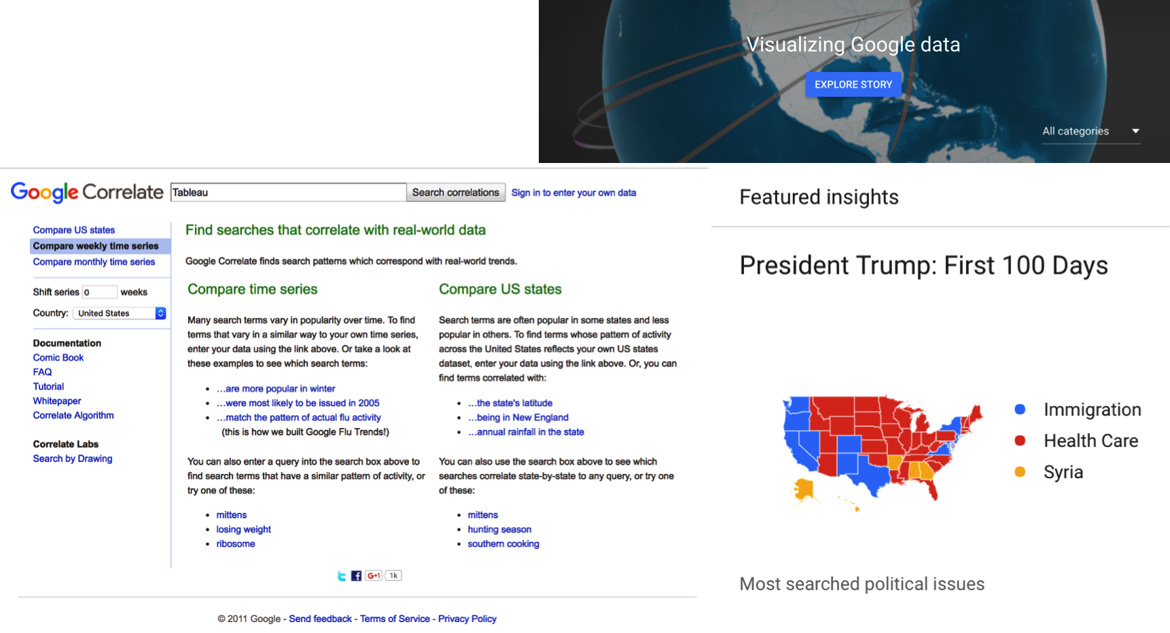
Search Insights: What Are We Looking for?
www.google.com/trends

Slide 3
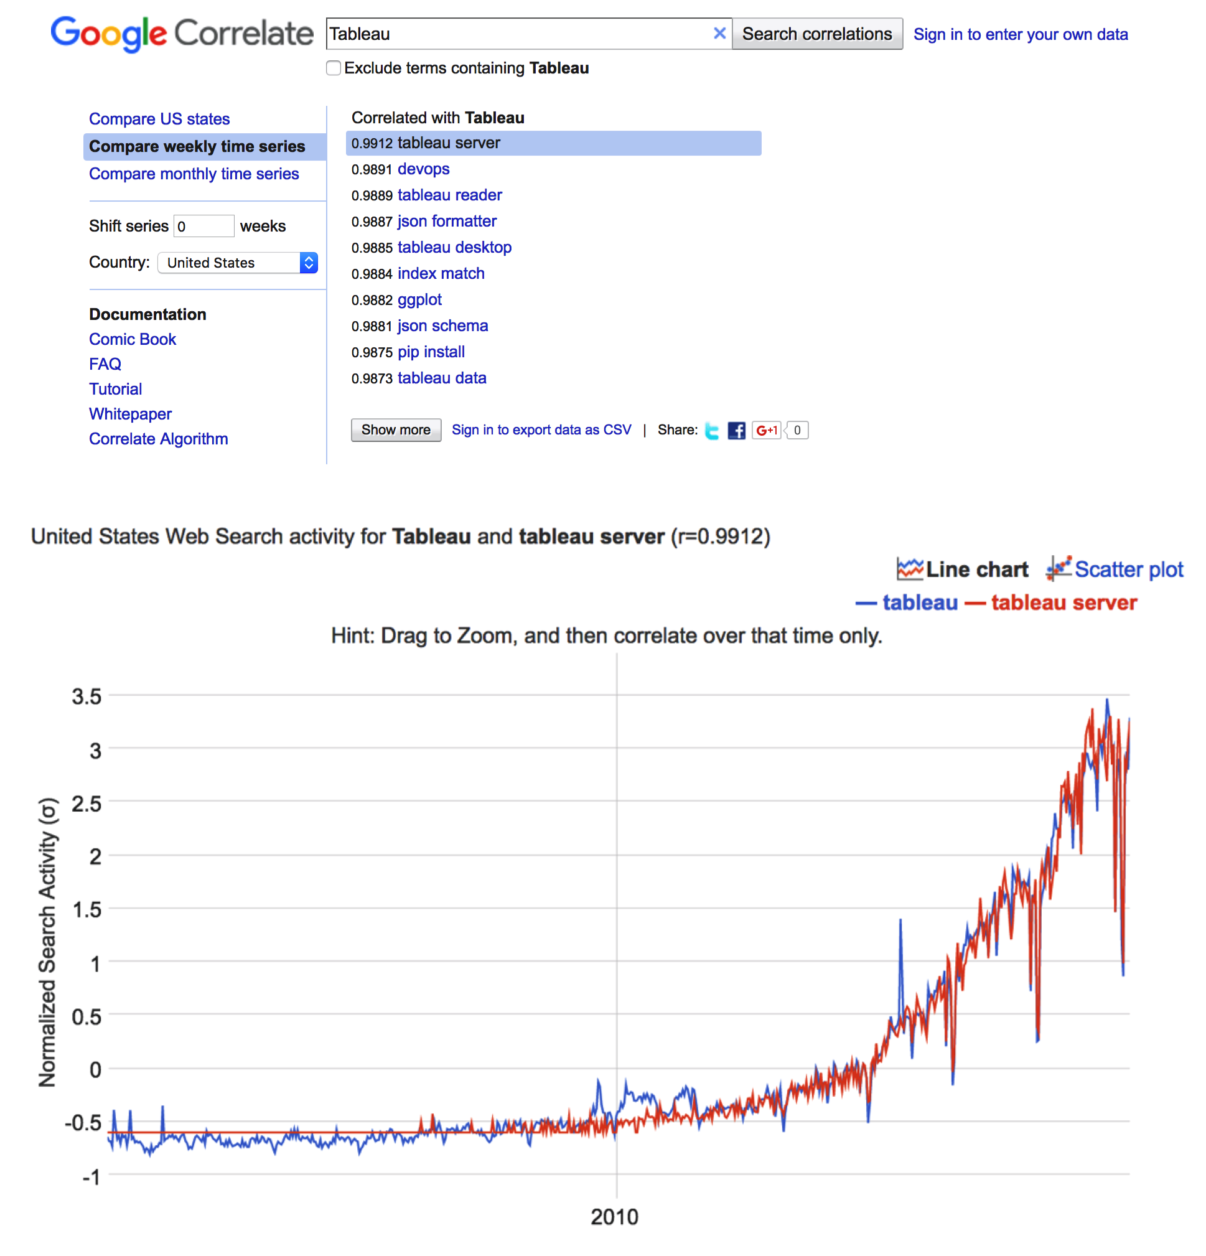

Slide 4
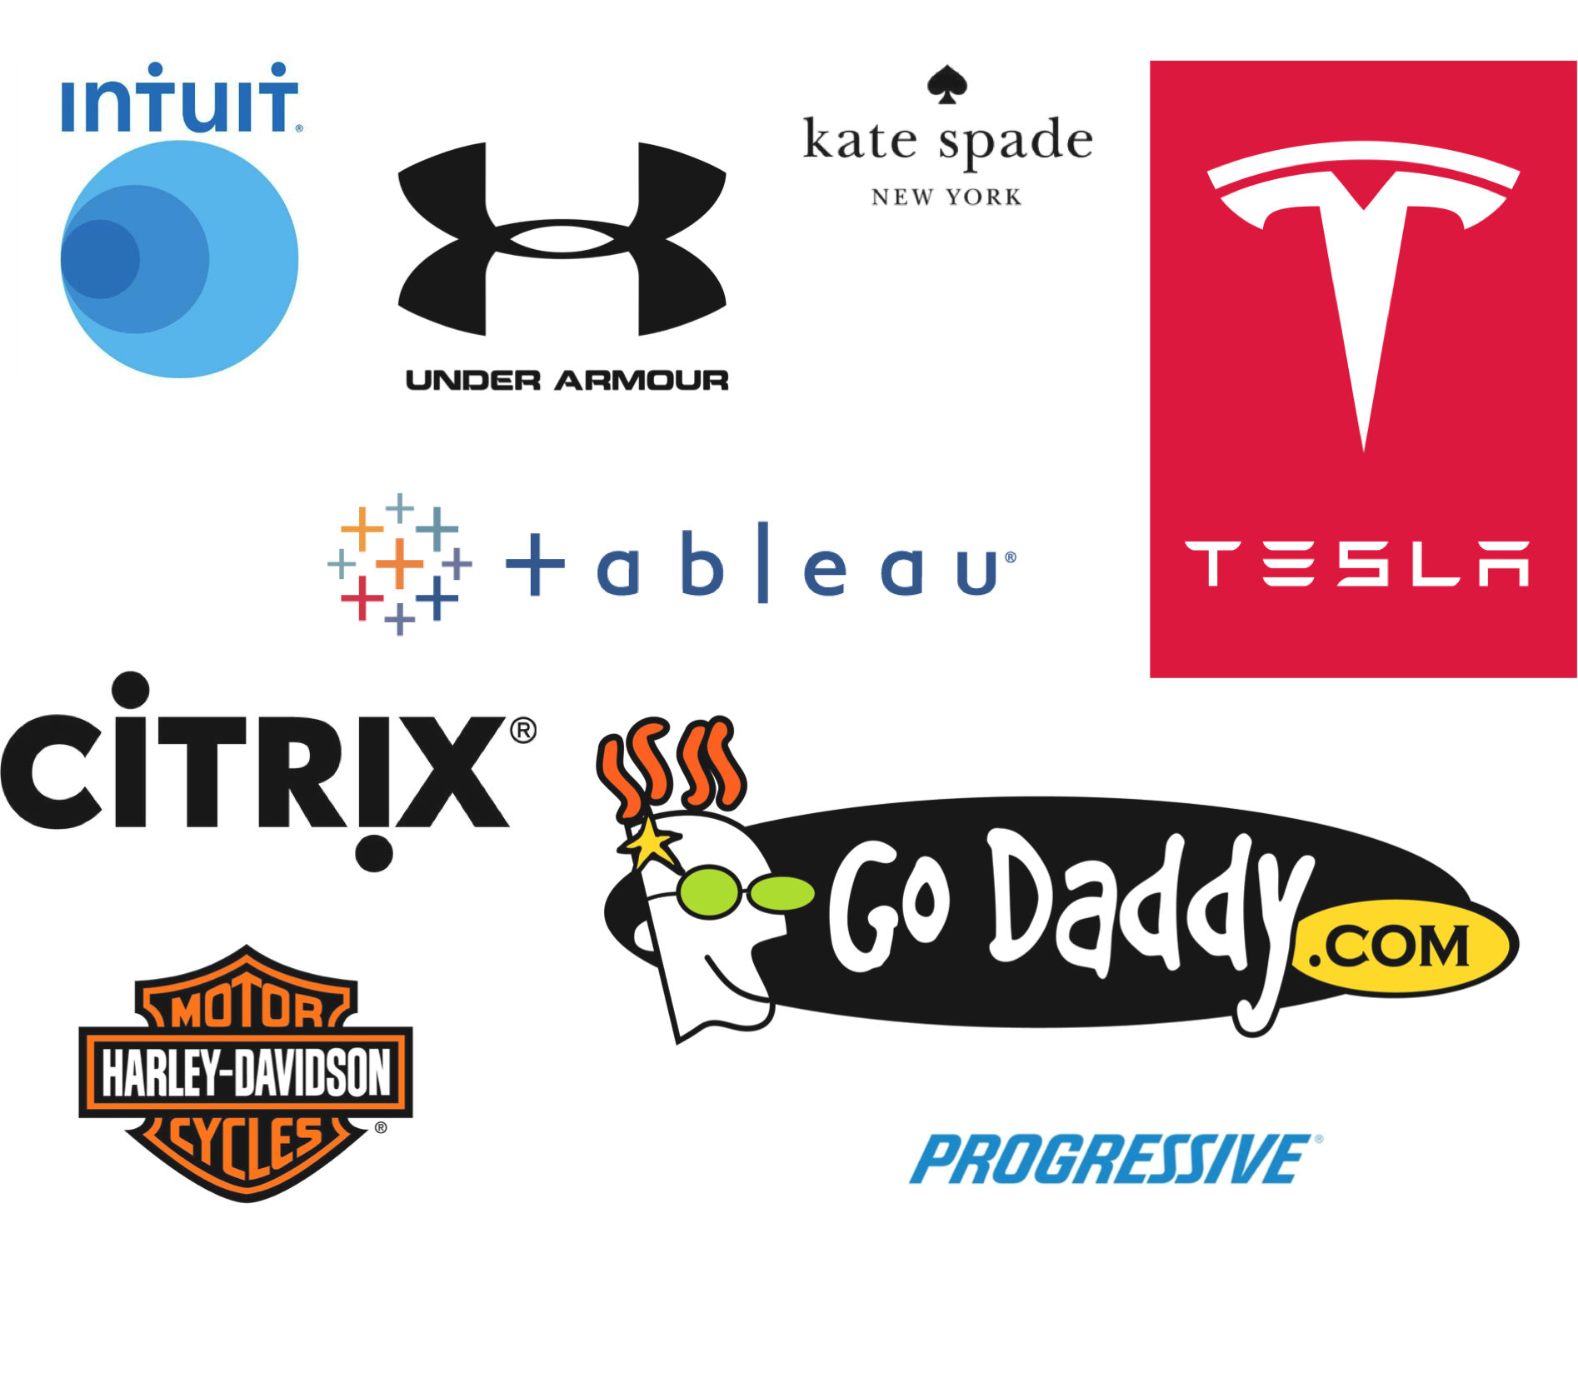

Slide 5
Data Assembled
Sources
Factset via API:
Company fundamentals & categorical data.
Google Correlate via Scrapy:
Time series of normalized search activity for a term & correlated search terms for that term.
Subset Selection
Companies chosen:
Component companies of Factset Market Indices for the following sectors -
Consumer Durables
Apparel / Footwear
Life / Health Insurance
Property / Casualty Insurance
Technology Services
Data
Factset:
Quarterly sales
Weekly share price
Weekly market capitalization
Weekly price / sales multiple
Weekly EV / EBITDA multiple
NAICS industry classification
Google Correlate:
Weekly time series of normalized search activity from 2004 – present for a company
15 highest correlated search terms to the company with Pearson correlation.
Respective search activity time series for the 15 highest correlated search terms, along with their 15 highest correlated search terms and correlations.

Slide 6
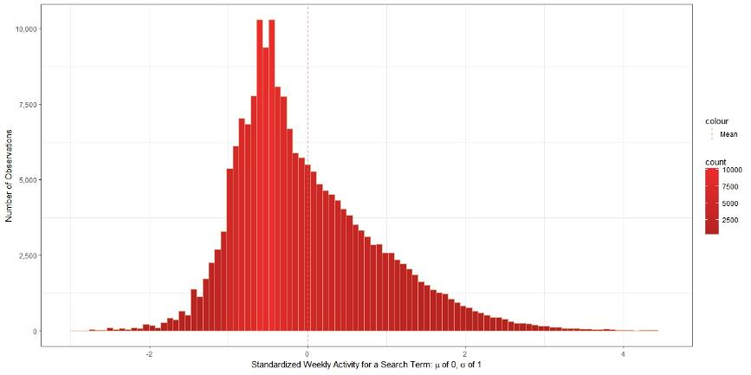
Distribution of Weekly Search Activity

Slide 7
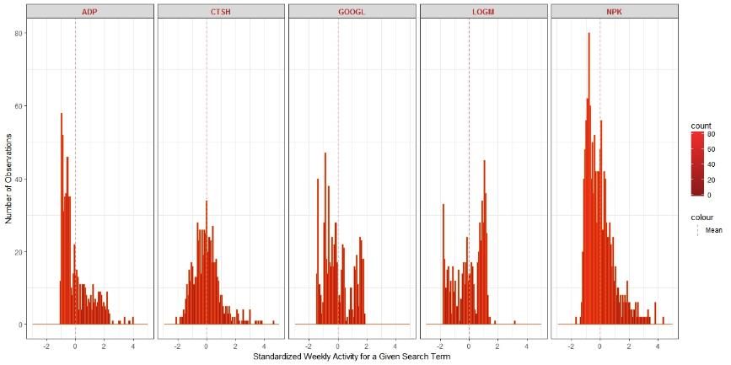
Distribution of Search Activity by Search Term

Slide 8
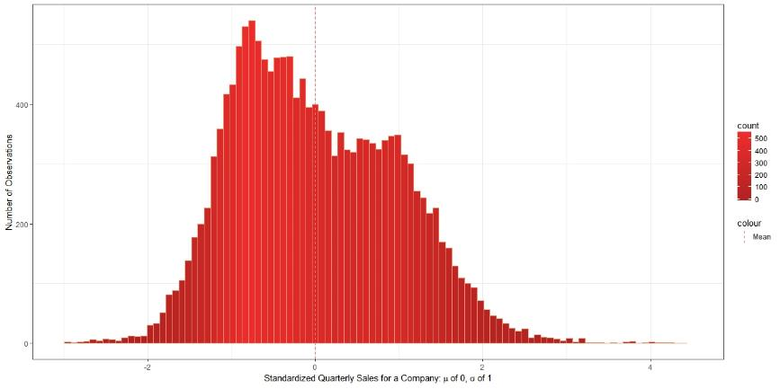
Distribution of Quarterly Sales

Slide 9
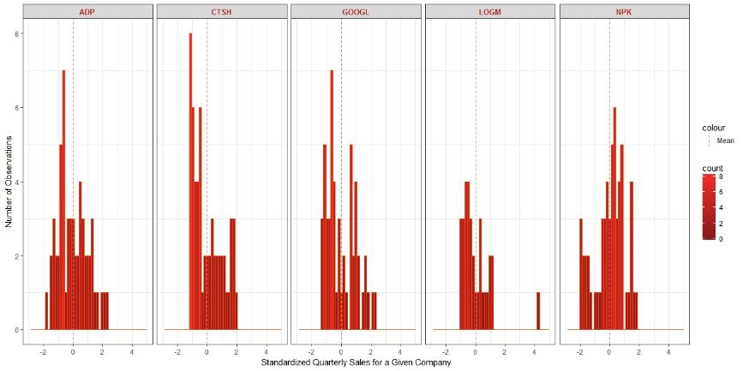
Distribution of Quarterly Sales by Search Term

Slide 10
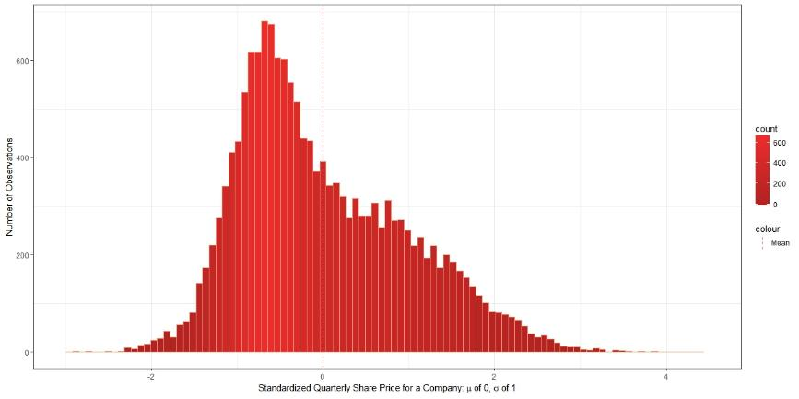
Distribution of Quarterly Share Price

Slide 11
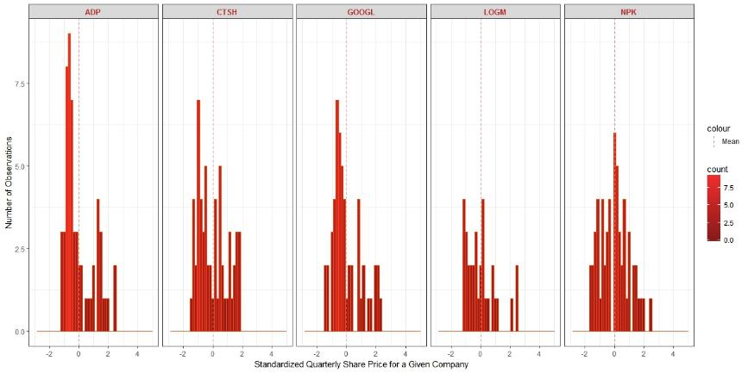
Distribution of Share Price by Search Term

Slide 12
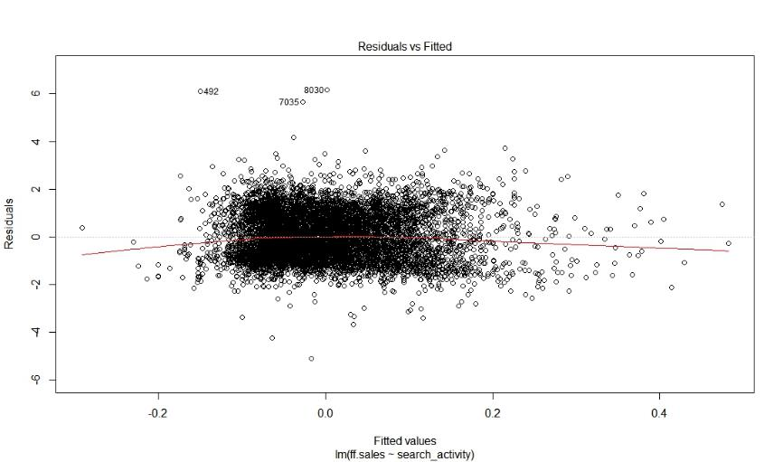
Initial Linear Regression of Quarterly Sales ~ Search Activity

Slide 13
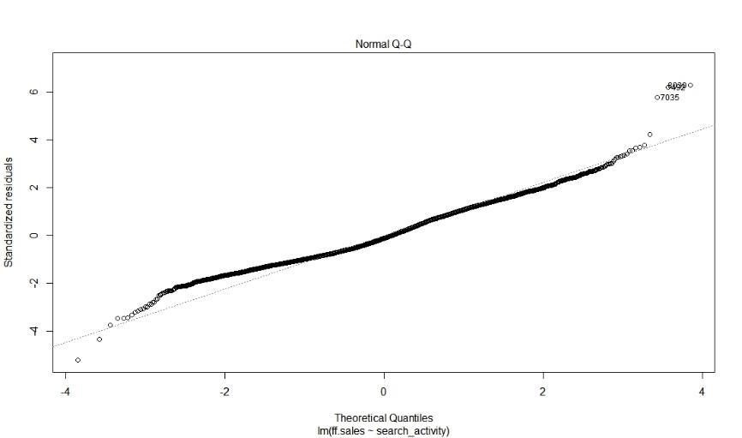
Initial Linear Regression of Quarterly Sales ~ Search Activity

Slide 14
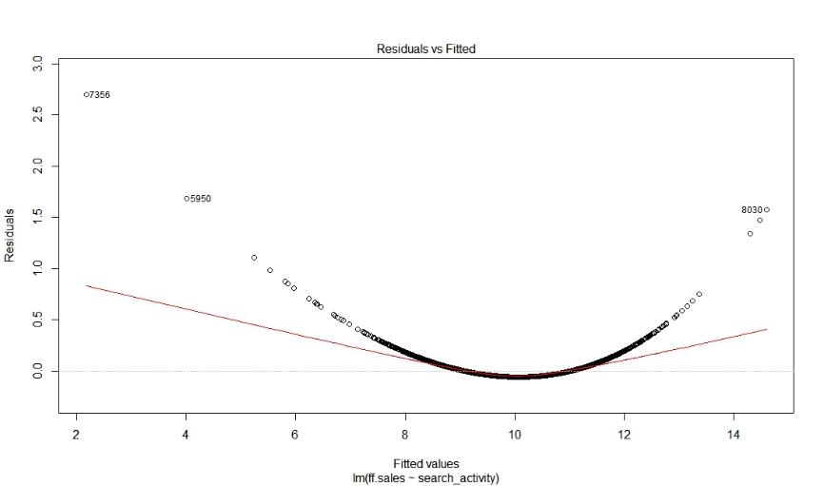
Linear Regression post- Box Cox Transformation

Slide 15
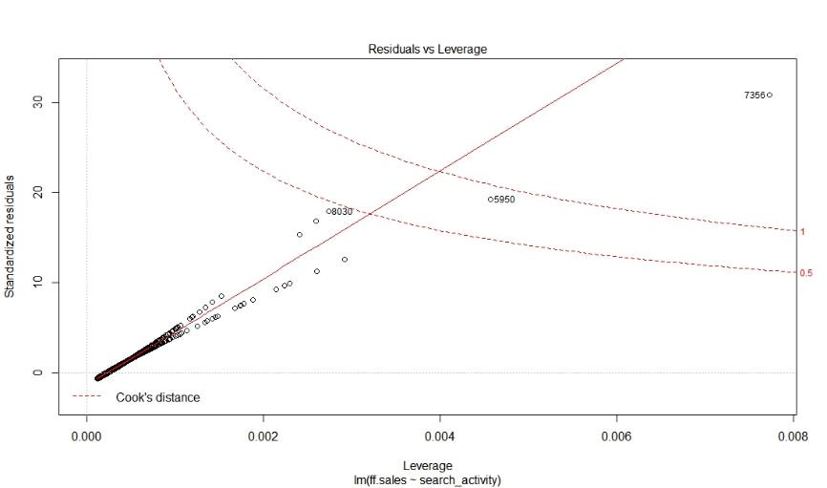
Linear Regression post- Box Cox Transformation

Slide 16
Take Aways & Further Work
Preliminary Conclusions:
Weekly search activity warrants further investigation to extract and properly leverage the underlying signal.
Linear regression of the standardized data presented zero correlation while the Box Cox transformed data presented a powerful R squared and p value.
Further investigation required for the model’s workability and potential over-fitting.
Further Work:
Visual inspection of a sample of correlated terms broughta hypothesis for further testing with the right NLP deployed:
Company search terms with top correlations to search terms relevant to its space (and not idiosyncratic or non-business impacting terms) offer a time series with more reliable / accurate signal for predicting company fundamentals.

